Slide 1
BM211 Introduction to Microbiology Workshop 5: Phylogenetic Trees
Dr Leighton Pritchard and Dr Morgan Feeney
Notes:
Welcome to the final workshop of BM211, where we’ll be introducing some principles of phylogenetic trees.

Slide 2
Family Trees
Notes:
I guess many of you will be familiar with the idea of a family tree.
We all have one, whether we know any details about it or not.

Slide 3
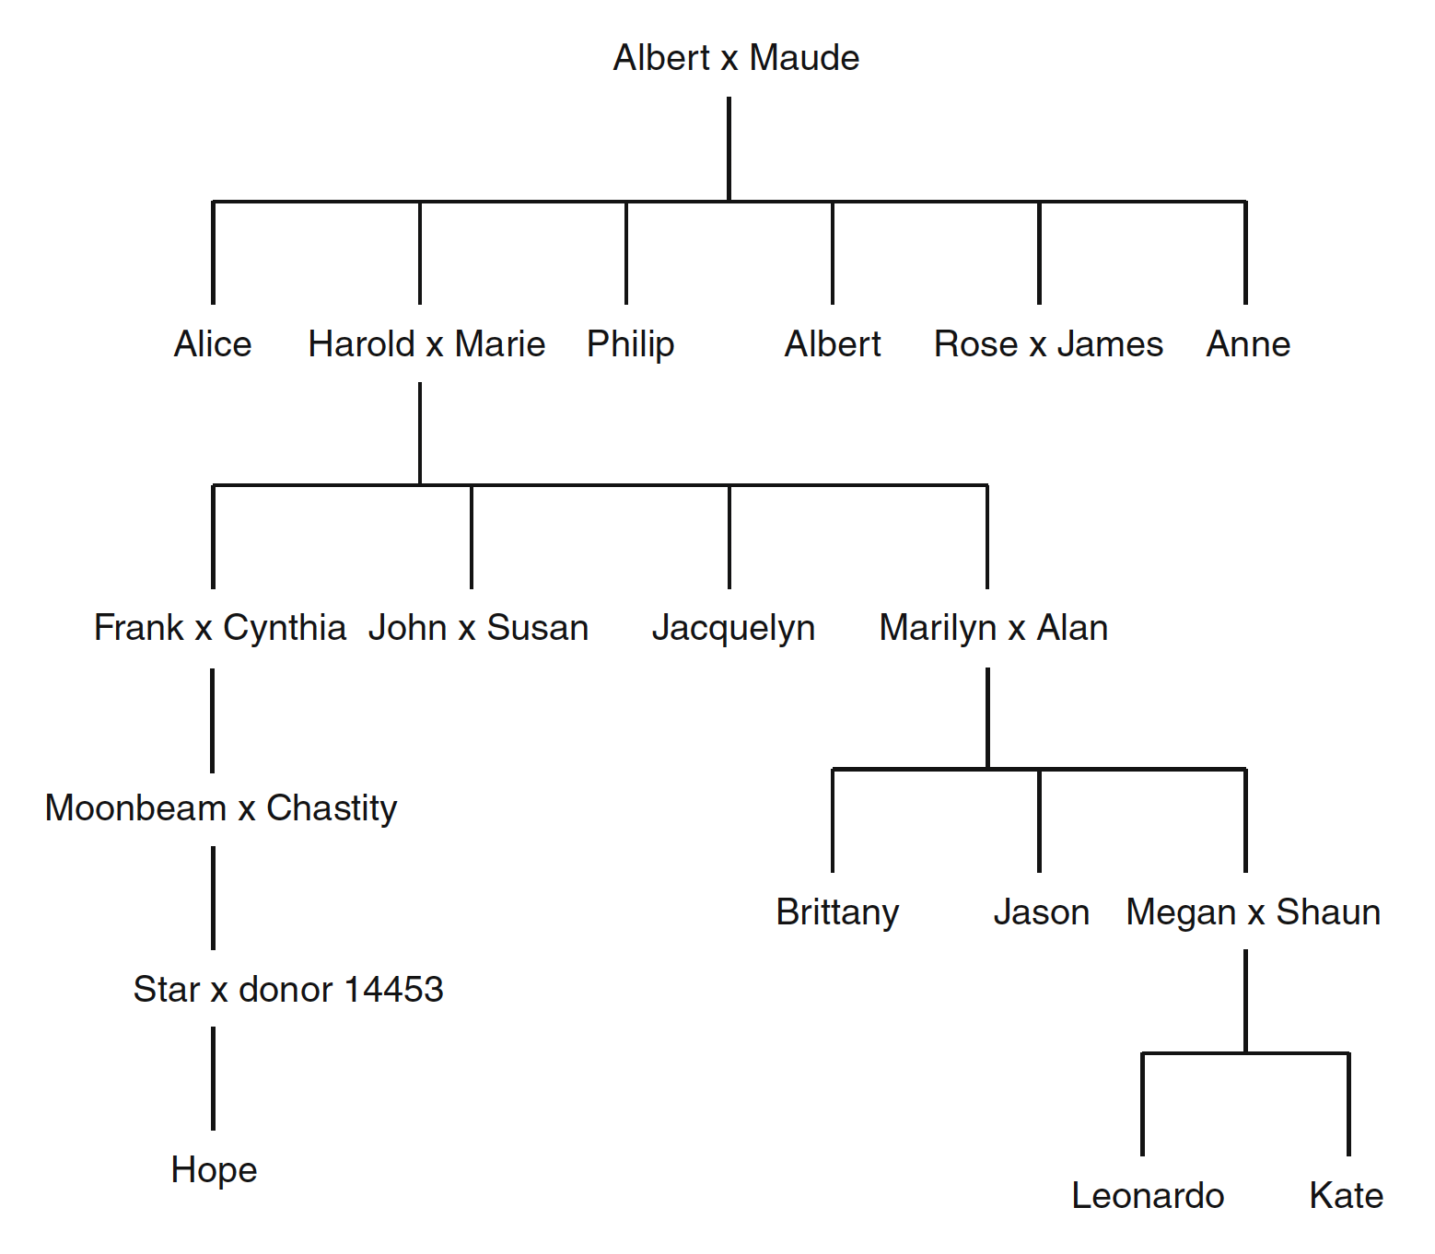
A family tree
Family trees represent
Relatedness
Reproduction
Nodes
People
(individual bags of genes)
Edges
Relationships between people
McLennan (2010) https://doi.org/10.1007/s12052-010-0273-6
Notes:
Family trees represent two key concepts: relatedness between individuals, and reproduction to generate new individuals.
Each node in the tree represents a person, and is labelled a name.
To be fair, biologically-speaking what each node represents is a bag of blood and genes – and it’s the collection of genes we’re typically interested in, as biologists.
Donor 14453 is essentially anonymous, but they have a place in the tree.
The edges in the tree represent relationships between the people.
Horizontal lines show peer relationships “on the same level”, like the siblings Leonardo and Kate, or the unions of John and Susan, or Moonbeam and Chastity.
Vertical lines represent relationships between generations: the union of Harold and Marie produced four offspring, that of Megan and Shaun produced two.
Hopefully you can see how this representation resembles a tree – even if upside down.
The root (Albert x Maude) is at the top, and the leaves – the most “recent” offspring are towards the bottom of the tree.

Slide 4
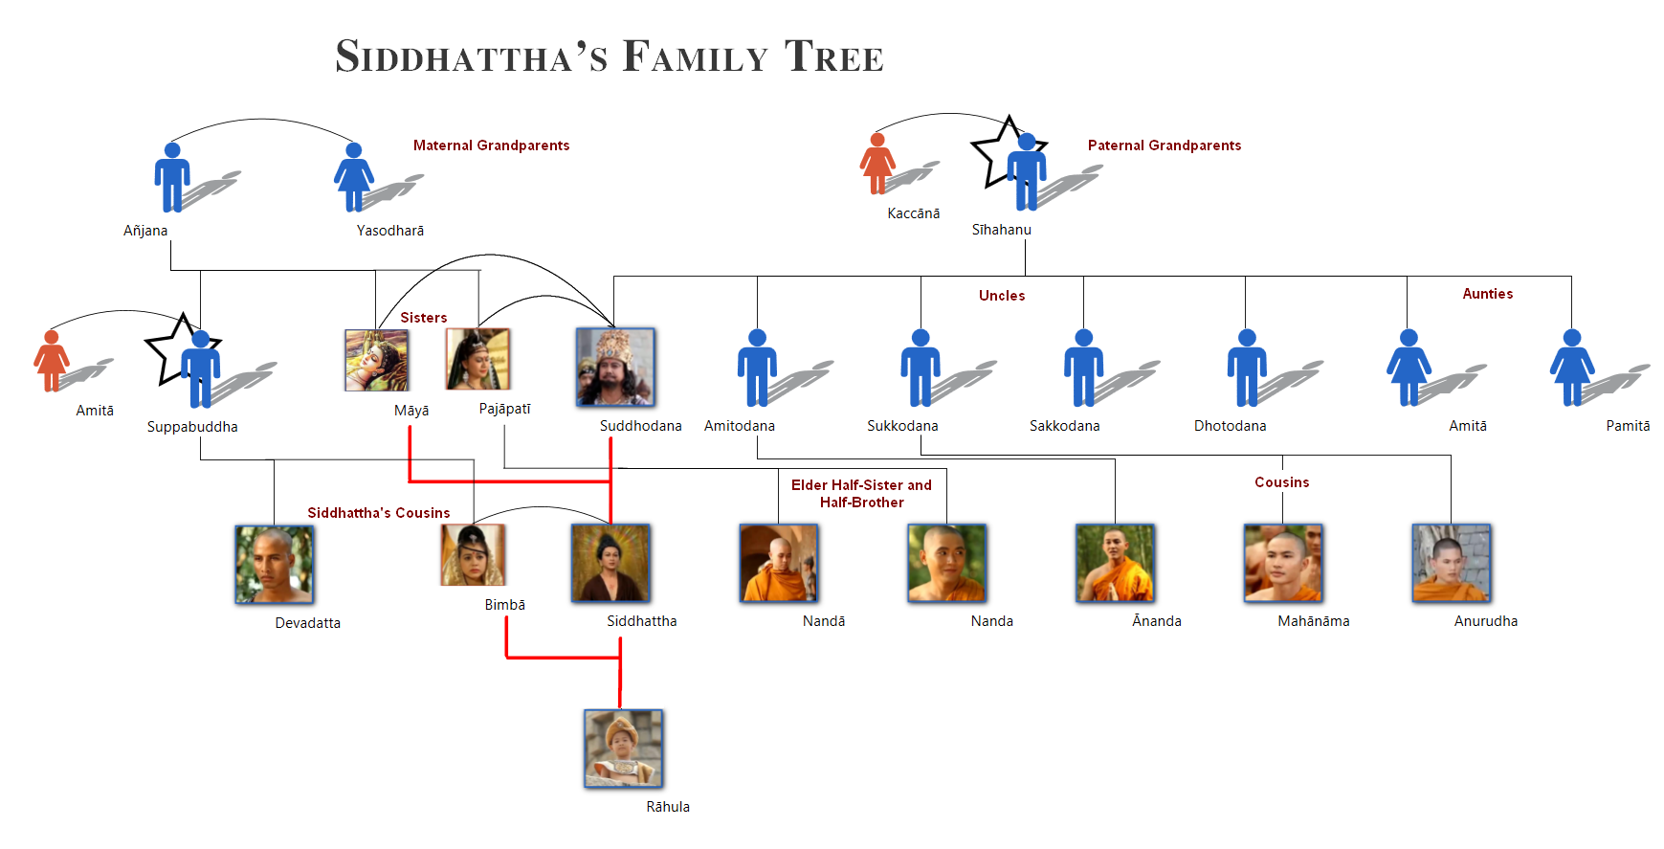
Another family “tree”
A tree, or a network?
Notes:
Life, and biology, is often more complicated than this, though.
Here’s the reconstructed family tree of Siddhattha Gautama, i.e. Buddha, and you can see that – much like many family trees, including my own, there is more of a network of relations between cousins and other relatives than might otherwise be assumed.
Family trees, and phylogenetic trees, are _models_ of what is usually more complicated reality.
The trees themselves are not the reality.
So, with that warning in place…

Slide 5
Phylogenetic Trees
phyle (Gr.): tribe or political subdivision
geneia (Gr.): origin
Notes:
Let’s talk about phylogenetic trees.
Phylogenetics, phylogeny, and related words have a Greek origin from phyle, meaning tribe or political subdivision, and geneia, meaning origin.
As you might guess from that, phylogeny is a way of dividing up individuals by
- Common membership of a group
The presumed origin of that group

Slide 6
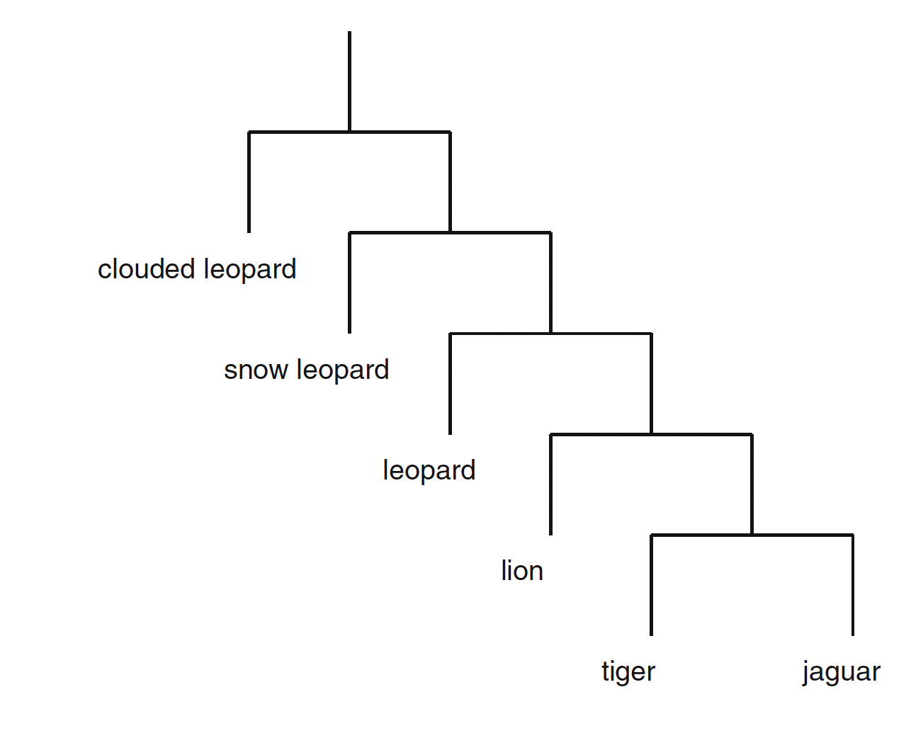
Phylogenetic trees
ancestor/root
Show speciation
Production of new species, not the full network of individual family relationships
Strictly bifurcating
descendants/leaves
McLennan (2010) https://doi.org/10.1007/s12052-010-0273-6
Notes:
You’ve all seen phylogenetic trees I’m sure, but as a recap…
Phylogenetic trees generally show speciation – the production of new groups, such as species.
They don’t tend to show the complete network of individual family relationships.
Moving down the tree from the common ancestor to the descendants, there is a sequence of splits into two groups at each division.
Phylogenetic trees tend to be _strictly bifurcating_
This represents – approximately - a population of organisms diverging into two distinct groups that no longer exchange genomic material
There are many ways in which this can come about, but the precise mechanism doesn’t matter: the tree looks the same however the situation arises

Slide 7
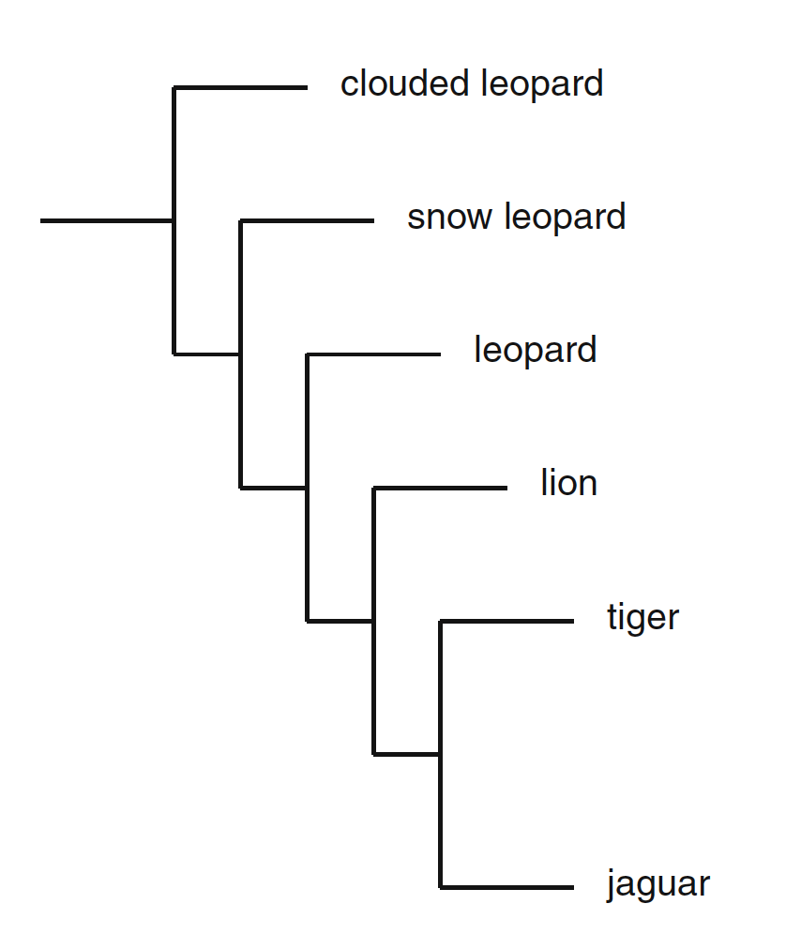
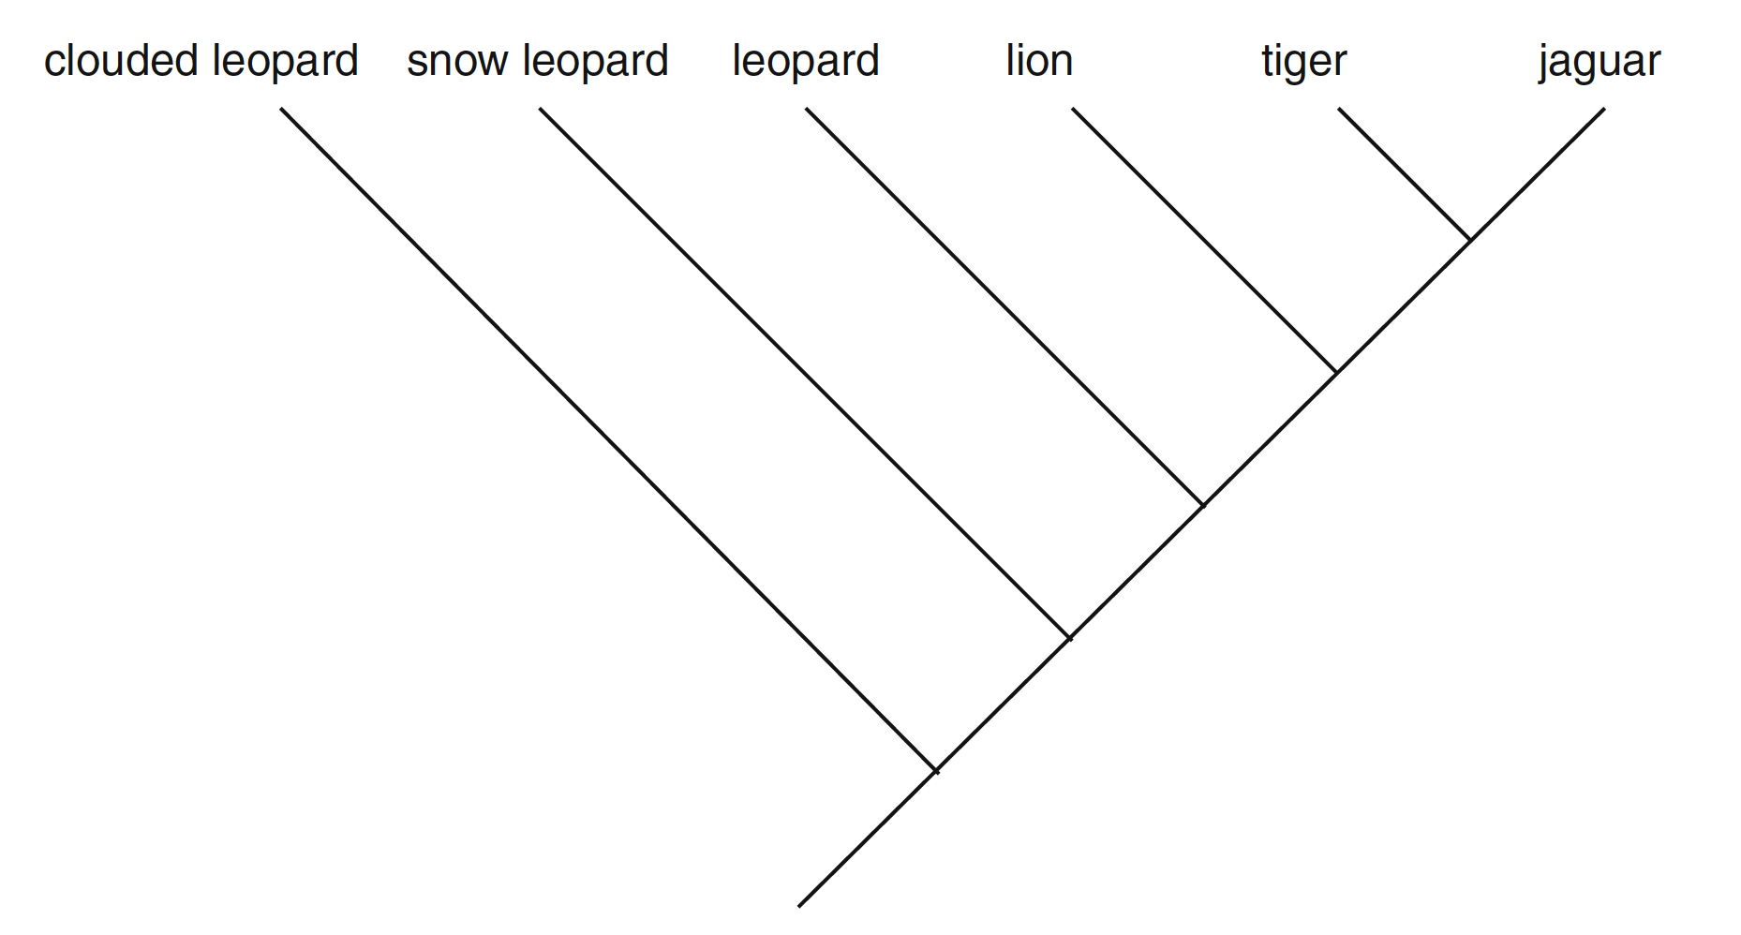
Branching order (topology)
descendants/leaves
ancestor/root
ancestor/root
These trees are the same as each other, and the last tree
descendants/leaves
McLennan (2010) https://doi.org/10.1007/s12052-010-0273-6
Notes:
Trees are just visual representations of the presumed relationship between organisms.
The same relationship can give rise to trees that are superficially different.
For example, we can rotate trees – here through 190 and 180 degrees, and we still have the same tree, describing the same relationship.
We can change from a rectilinear tree (bifurcations come at right angles) to a sloped or angled tree (bifurcations have this angled split).
But you can see that the order of branching from the root to the leaves is the same in all cases.
The clouded leopard splits off first, then the snow leopard, then the leopard, and so on.
The tiger and jaguar are the last to split, or _diverge_.
This branching order is called the _topology_, and is what represents the relationships between each species in the tree.

Slide 8
Ancestors and history
Phylogenetic trees represent
ancestors
history
unique history of clouded leopard
shared history of tiger and jaguar
unique ancestor of leopard
common ancestor of leopard, lion, tiger, and jaguar
McLennan (2010) https://doi.org/10.1007/s12052-010-0273-6
Notes:
We can interpret the tree as, in a way, representing the ancestors of each species, and the history of how the species arose.
Each point leading from the leopard leaf of the tree to where it meets the rest of the tree represents an ancestor of the modern-day leopard that is not shared by any of the other species in the tree.
The bright green line here then, represents the unique evolutionary history of the clouded leopard – no other species in the tree shares any of this.
The other point indicated, on a section of tree between the leopard and snow leopard, represents something that was ancestral to all leopards, lions, tigers, and jaguars – a _common ancestor_ of all four species.
It arose _after_ snow leopards split from the group, so this ancestor is not an ancestor of the snow leopard.
The dark green line between lion and tiger, similarly, represents the common, shared evolutionary history of only the tiger and jaguar, but not the lion.

Slide 9
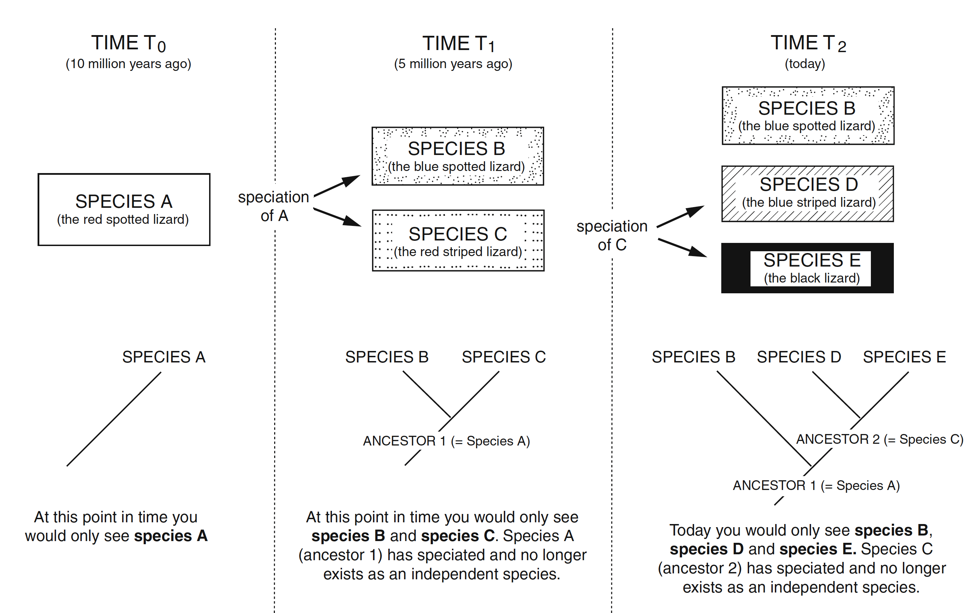
Phylogenies are time travel
McLennan (2010) https://doi.org/10.1007/s12052-010-0273-6
Notes:
In this way, phylogeny lets us travel through time.
Today, we see the species that are around us – here species B, D, and E.
The ancestral organisms giving rise to these species are no more. We might find fossils in some cases, but generally the evidence we have is genomic, and comprised entirely of sequence data that we must analyse using bioinformatics.
This is what allows us to reconstruct trees like this one on the right, which suggests that 5mn years ago species D and E shared a common ancestor (species C) that they didn’t share with species B.
Going further back in the tree, we can see that it suggests all three species shared a common ancestor 10mn years ago – species A.
If we did a good job making our tree, maybe this truly represents a biological reality, where the red spotted lizard diverged into two species: blue spotted and red striped lizards, and the red striped lizard became blue striped, and black lizards.
We can’t usually know for certain.
Trees are typically models we build on the basis of things we know _now_ - we’re trying to see into the past, but the picture can be unclear.

Slide 10

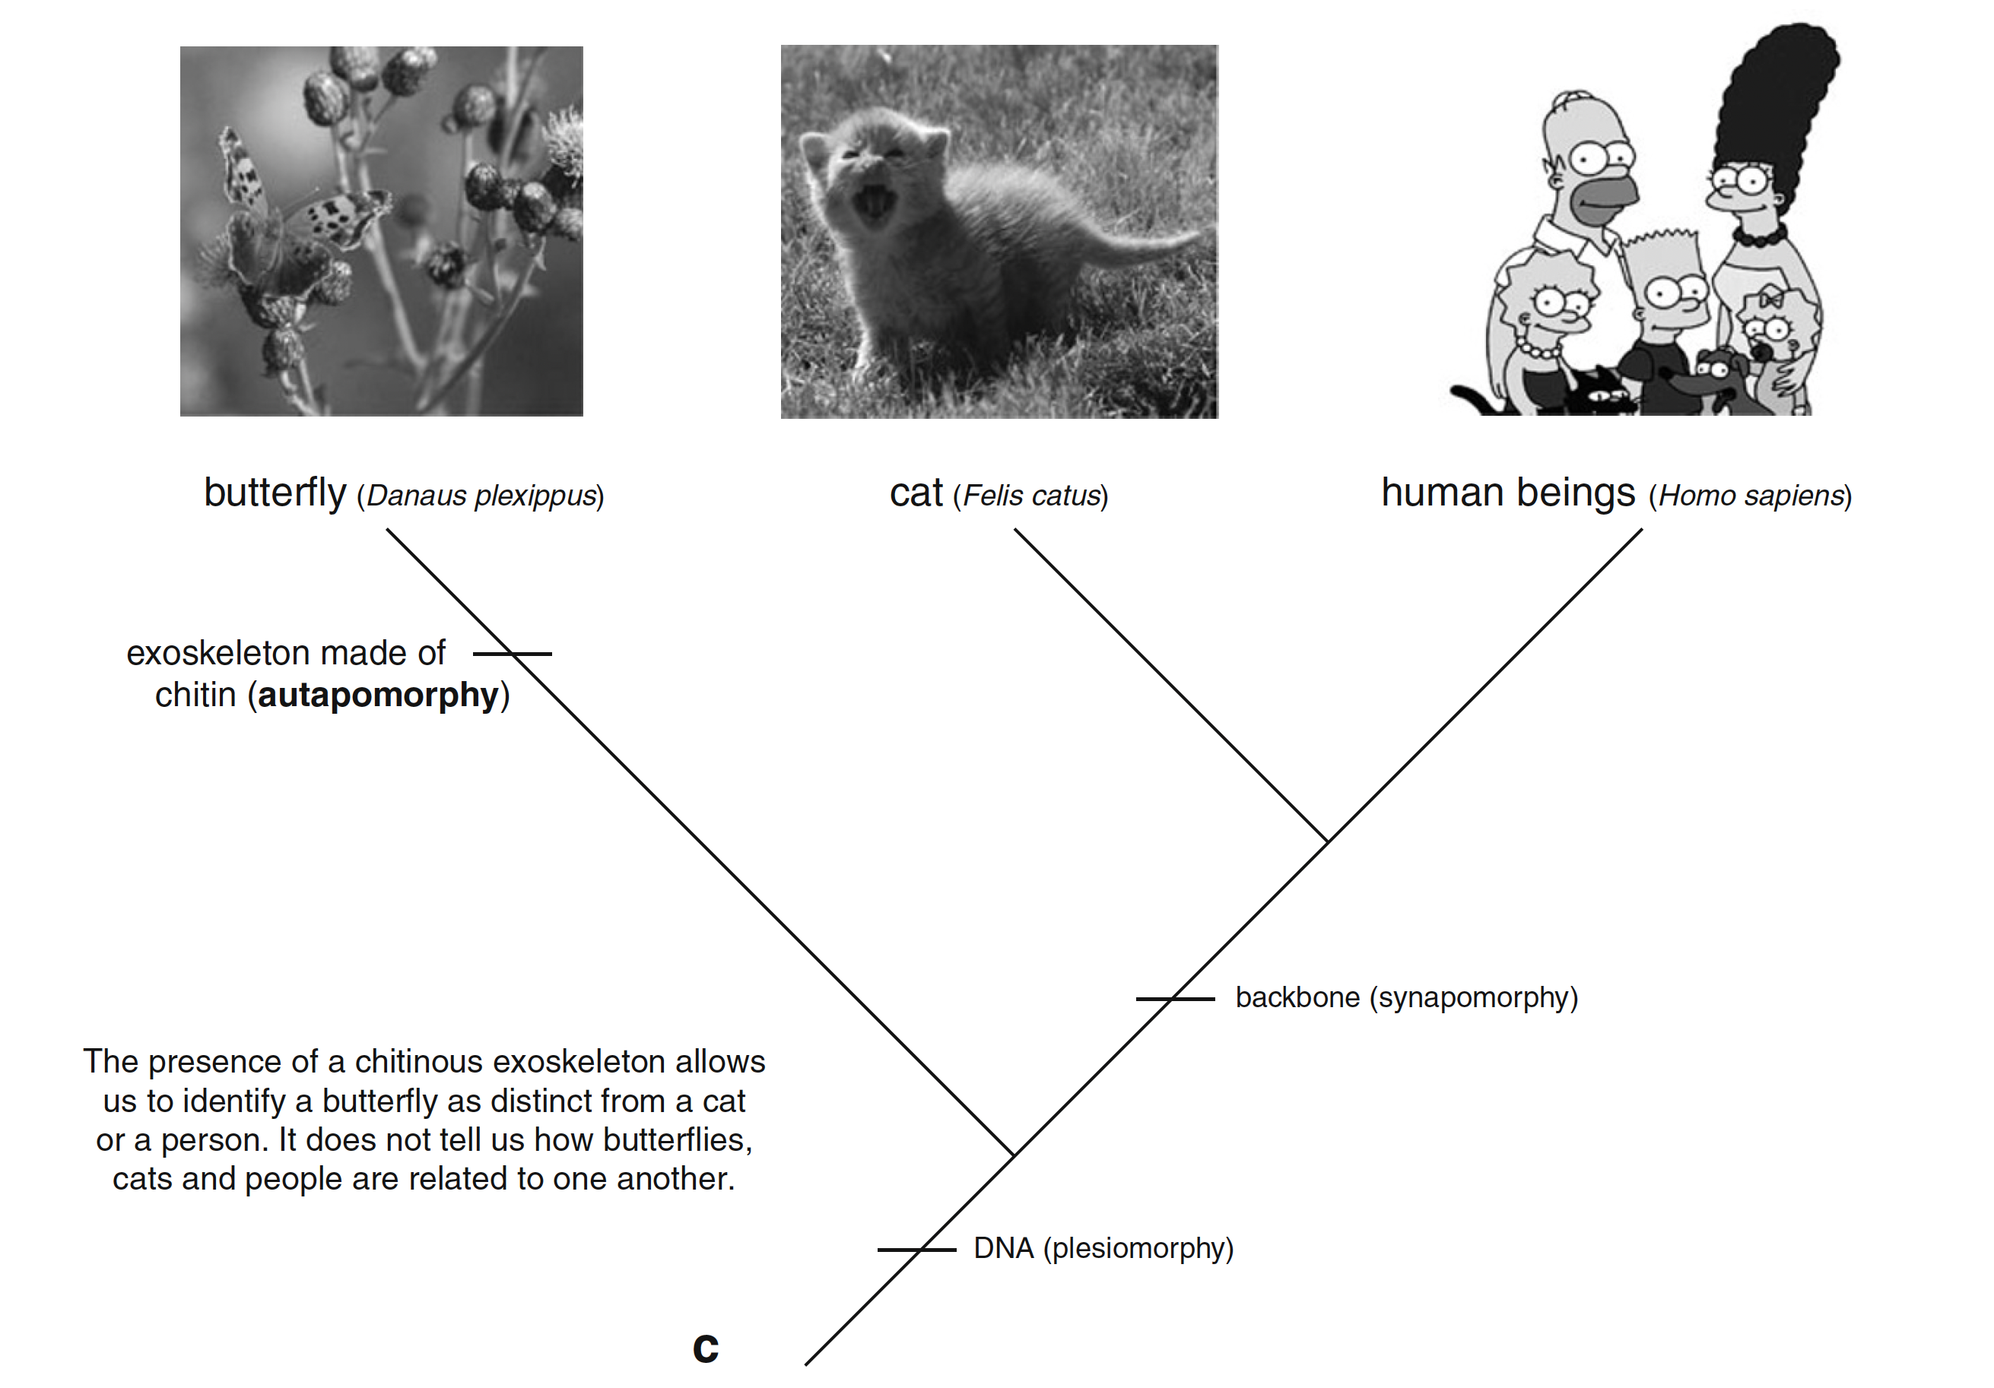


Trees represent shared properties
butterfly
cat
human
chitinous exoskeleton
Has a tail
not been funny for >20 years
backbone/spine
How do we get shared properties from sequence data?
presence of DNA
McLennan (2010) https://doi.org/10.1007/s12052-010-0273-6
Notes:
Trees also represent shared properties between organisms.
One convention when doing this is to mark the shared characteristics on branches of the tree with lines like this.
Here we have a tree with butterflies, cats, and humans.
All of them have genomic material built on DNA (it’s not the only shared characteristic), so we can mark this in at the ancestral branch, by the root.
Butterflies have a chitinous exoskeleton, but not a spine (which is shared by cats and humans) – so we can mark these properties in, in the same way.
And finally, cats have tails, and The Simpsons hasn’t been funny for a good two decades, so these are distinctive features of cats and humans.
But as I mentioned earlier we build these trees from sequence data.
So how do we get these shared properties from sequence data?

Slide 11
(Multiple) Sequence Alignments
Making trees from biological sequences
Notes:
We typically do this using multiple sequence alignments of sequences from each organism.

Slide 12
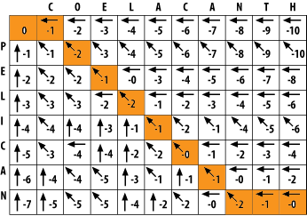
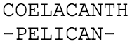
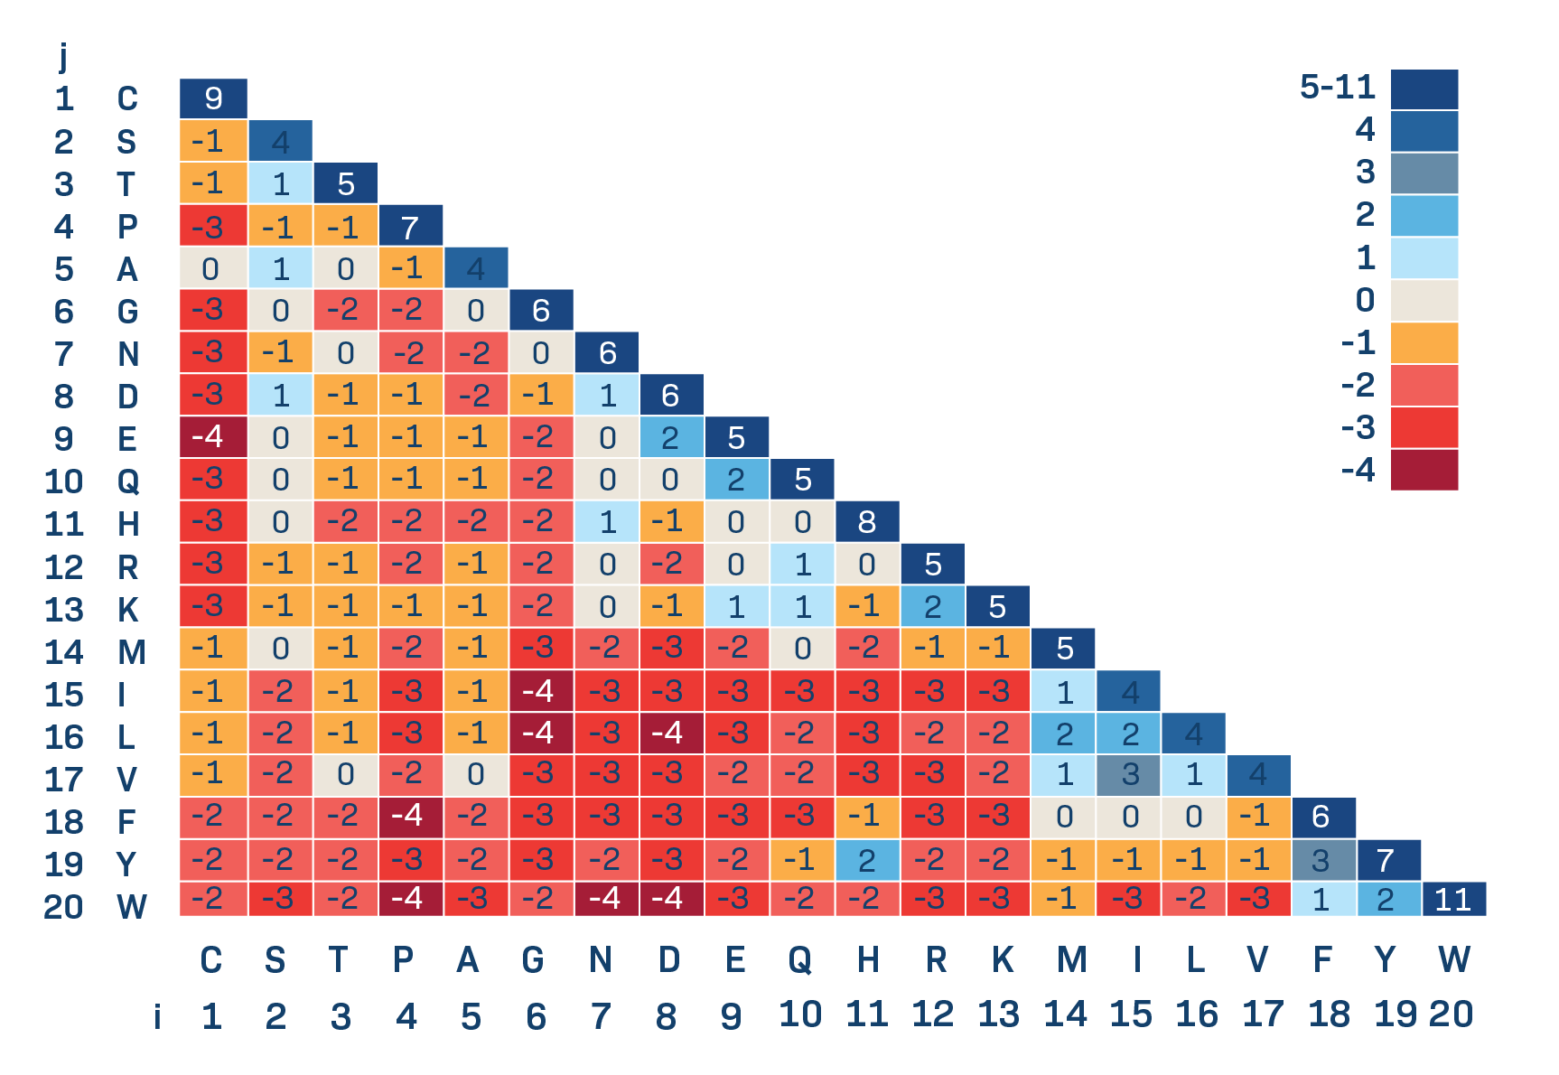
Pairwise Sequence Alignment
You’ve met pairwise sequence alignment
BM214 Workshop 2
Mathematical algorithm
Two sequences of symbols
Move sequences of symbols relative to each other by inserting gaps
Optimise for a score
The scoring scheme represents the biological part of sequence alignment
Notes:
You’ve already met pairwise sequence alignment in BM214.
As a reminder, this is a mathematical algorithm that optimizes a score obtaing by moving symbols of sequences/inserting gaps into the sequences.
You’ll remember that the biological component of this is the choice of scoring scheme for alignment – if we choose this well we’ll get a good alignment.

Slide 13
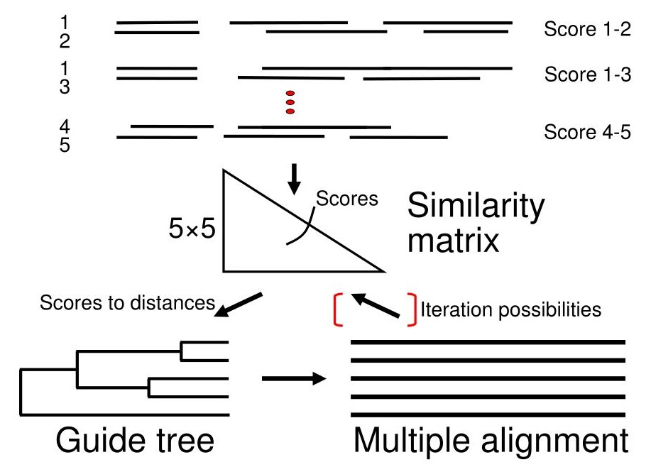
Multiple Sequence Alignment (MSA)
Mathematically much more difficult (NP-complete)
Approximated by progressive alignment
Build a guide tree from aligned sequence pairs
Start with the most similar pair of sequences
Include the next-most-related pair and adjust the alignment if needed
(repeat this until done)
(optionally use the new alignment to do the whole thing again: iterative MSA)
Not guaranteed to be optimal
Notes:
Multiple sequence alignment is similar, but mathematically much more difficult.
It belongs to a class of problems called “NP-complete problems” – which means that we don’t have an algorithmic way to optimize the solution.
Actually, it’s worse than that, for “NP-complete problems” we don’t even know if there exists an algorithmic way to optimize the solution.
As a result, every multiple sequence alignment method uses a series of shortcuts, called heuristics, to approximate a good alignment.
A common approach is progressive alignment. This works by:
Aligning every sequence pairwise against every other sequence in the dataset to obtain a “distance matrix”
Building a “guide tree” from this distance matrix
Working from the most closely-related pair of sequences, we add the next most-closely-related sequence and try to optimize the joint alignment.
Then repeat over and over from the most closely-related group of sequences
No MSA algorithm is guaranteed to be optimal, or biologically correct.

Slide 14
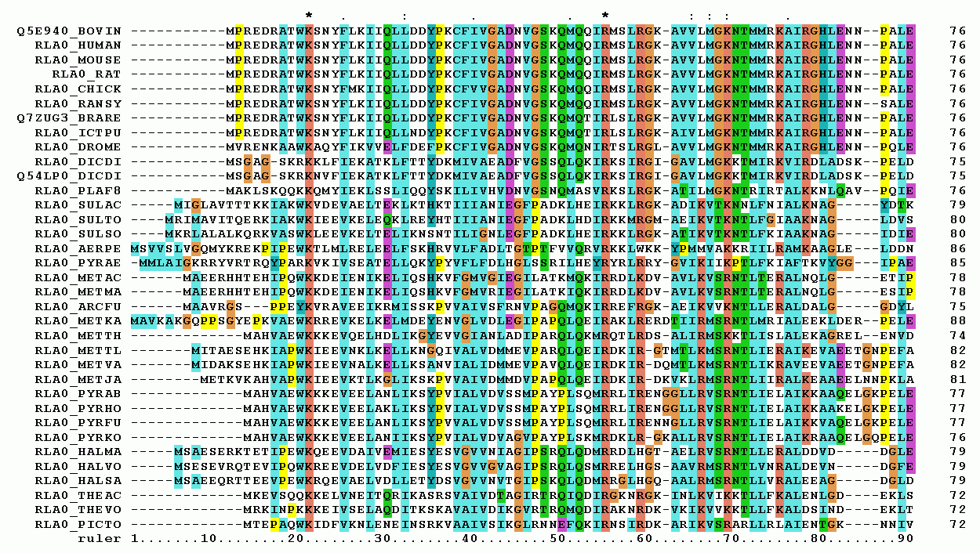
Characters
The MSA tells us which positions are evolutionarily equivalent
(they’re in the same column)
These are the shared properties we need
We can use the changes in equivalent positions to estimate evolutionary/genetic changes, and use this to build a tree
conserved/ no change
several substitutions
Notes:
But they are incredibly useful.
They give us multiple sequence alignments that look like this, and tell us which positions in the sequence are likely to be “evolutionarily equivalent” (because they’re in the same column)
Being in the same column implies that the residues – or bases – at that position share a common ancestor in the common ancestral sequence.
Changes in the column are assumed to be associated with bifurcations and generation of new lineages through evolution.
These column of evolutionarily equivalent positions are the shared properties we need to build a phylogenetic tree.
To do this, we use differences across equivalent positions to estimate evolutionary and genetic changes
These then allow us to construct a tree

Slide 15
Tree-building Methods
Notes:
So how do we make a tree from these alignments?
We’ll not go into detail, but you should know that there are two main approaches.

Slide 16
Two main approaches - 1
Algorithmic (bottom-up/distance matrix/clustering)
UPGMA
Neighbour-Joining
Modelling (find a tree that best fits the data)
Maximum parsimony
Maximum likelihood
Bayesian inference
See BM329 workshop page for UPGMA summary: https://sipbs-compbiol.github.io/BM329_Block_B_Workshop/upgma.html
Make a distance matrix from the MSA
(Main influence of biology)
Find the most closely-related pair and join them
Repeat until all sequences are joined
(Assumption of bifurcating tree)
Notes:
The first approach is algorithmic and bottom up.
These methods use similarities between sequences to make a distance matrix , and then join them together – the most similar first – until all sequences are joined.
This approach is usually deterministic and repeatable (the same data and settings give the same tree)
But they don’t represent biological/evolutionary history very accurately.

Slide 17
Two main approaches - 2
Algorithmic (bottom-up/distance matrix/clustering)
UPGMA
Neighbour-Joining
Modelling (find a tree that best fits the data)
Maximum parsimony
Maximum likelihood
RaxML
Bayesian inference
MrBayes
Assume that a bifurcating tree structure is correct
Find the tree that explains the data better than any previously-seen alternative tree
Maximum parsimony: minimize the number of character-state changes (i.e. site substitutions)
Maximum likelihood: the most probable tree, given a statistical model of site substitution probabilities
Bayesian: the most probable tree, given a set of prior assumptions, such as a model of site substitution probabilities and/or known relationships between sequences
Notes:
The other approach is a modelling approach.
In these methods, we have a mathematical idea of how evolution works – which bases are more likely to change into each other, for instance.
Then we – statistically – try to find the tree that fits the data best, given our model of evolution.
These are not typically deterministic, and will often give different trees for the same dataset and settings, which reflects our real uncertainty in modelling evolution.

Slide 18
The Workshop
Build and visualize your own tree
Notes:
So what will you be doing today?

Slide 19
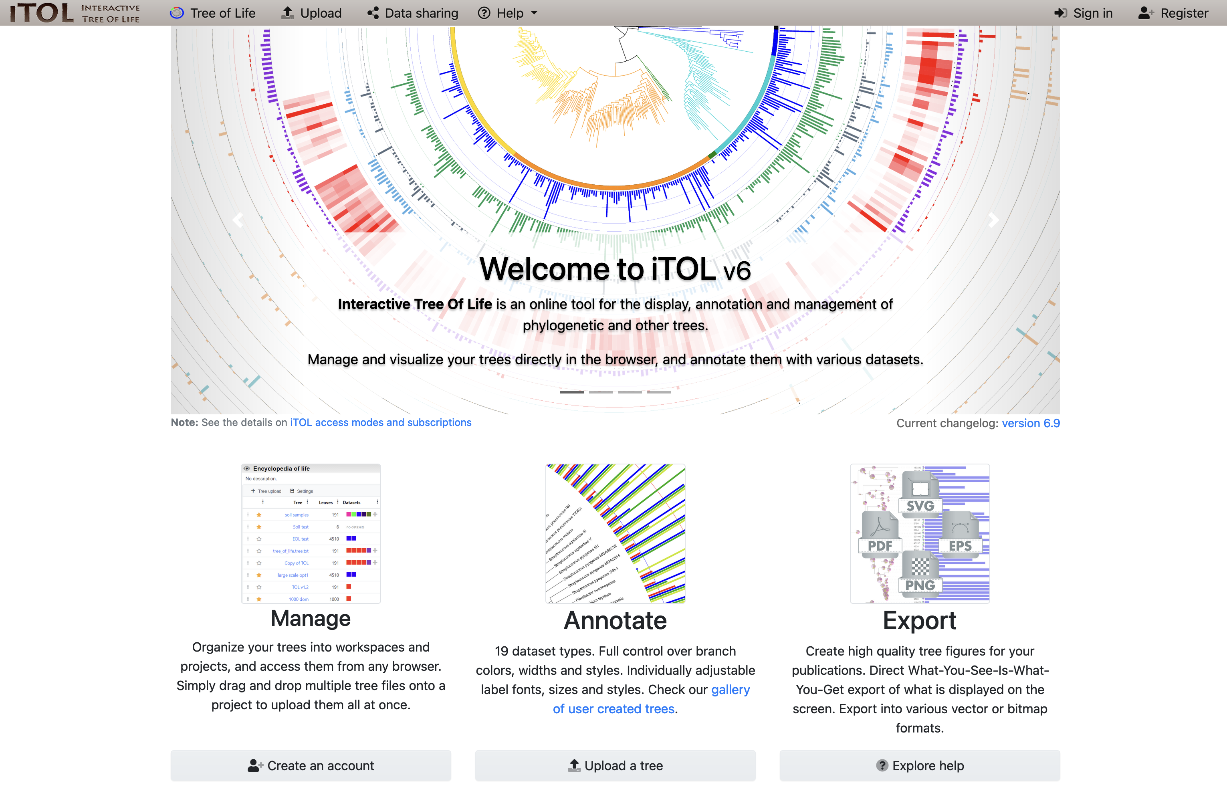
Part 1: Get a tree and upload to iToL
We supply a tree file
tree_newick.nwk
Download it from the workshop page
Upload it to iToL (interactive Tree of Life)
Read through the material and answer the MyPlace formative quiz
Notes:
Today, you’ll be working with phylogenetic trees and drawing them using an online tool called iToL: the interactive tree of life
There is some further explanatory material in the workshop, and a formative quiz related to this.

Slide 20
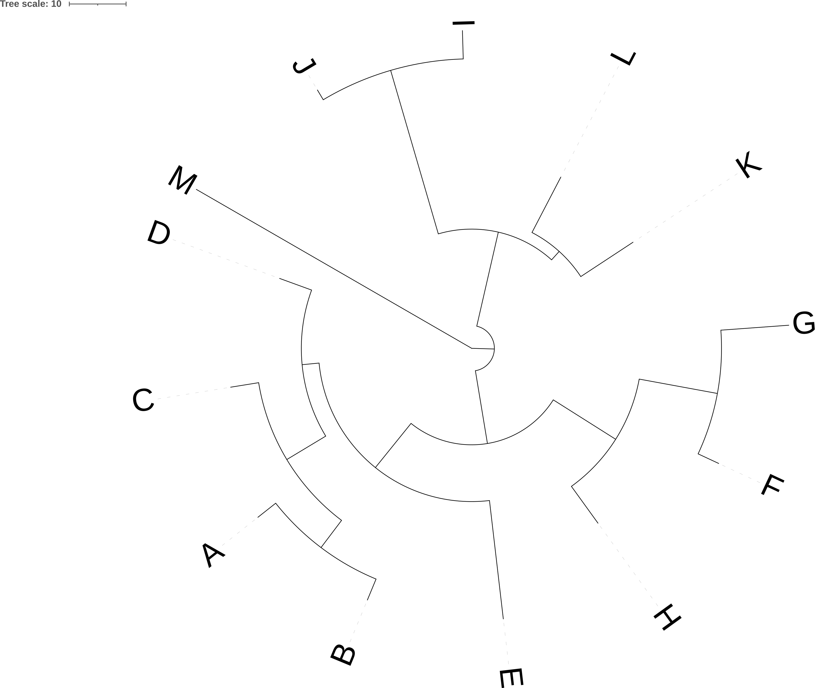
Part 2: Types of phylogenetic tree
Render your tree in a number of ways using iToL
Read through the material and answer the MyPlace formative quiz
Notes:
The material will guide you through construction of a number of different tree visualisations, emphasizing different aspects of the relationships between the organisms you’re working with.
Again, there is a formative quiz on MyPlace at the end of this section to ensure you’re on top of the methods, because…

Slide 21
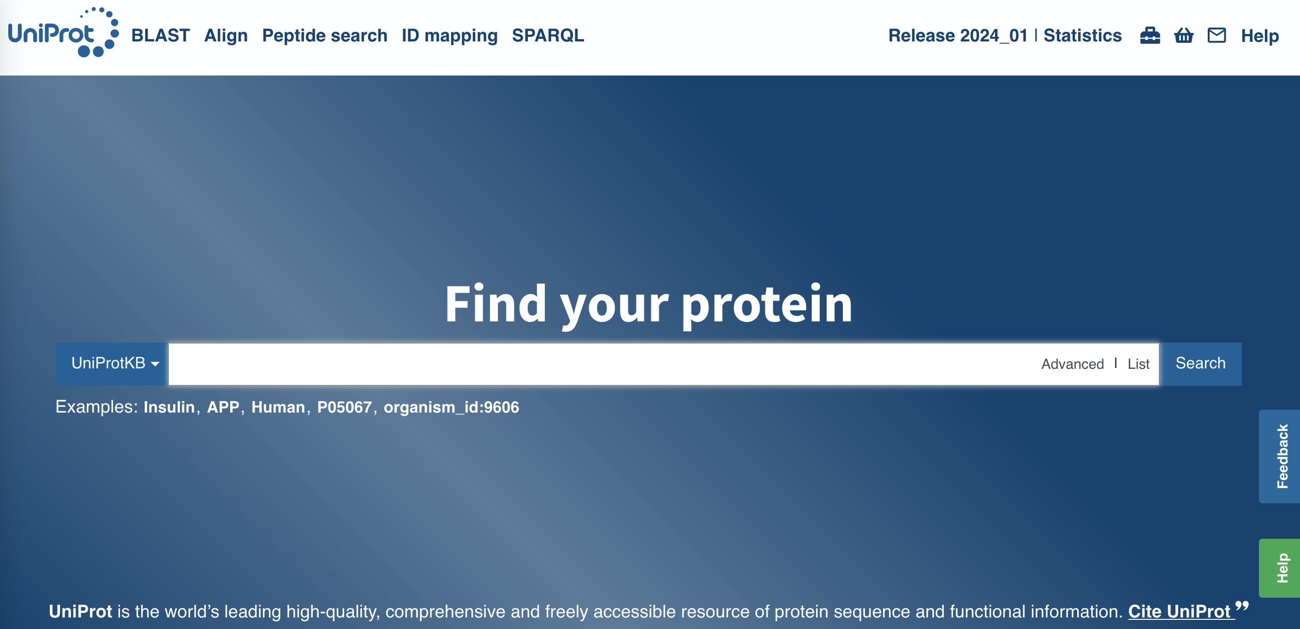
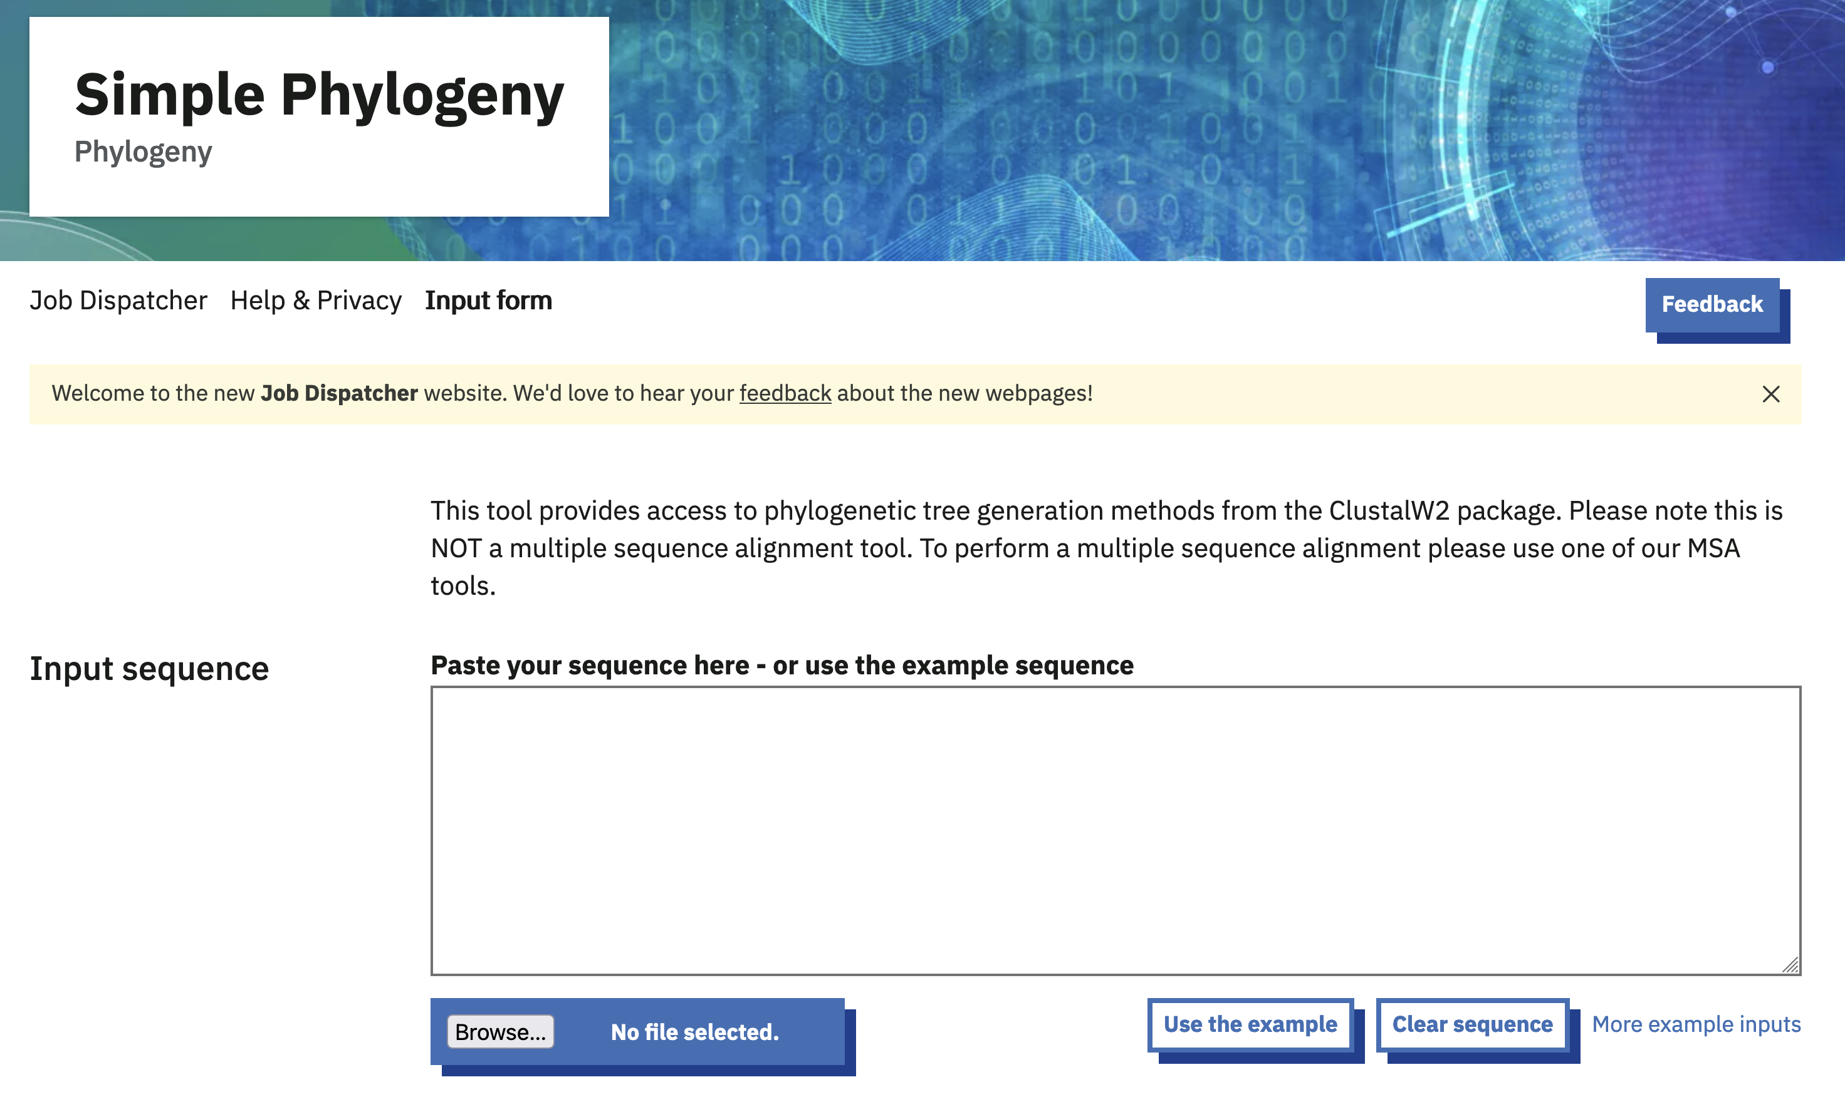
Part 3: Make your own phylogenetic tree
Acquire sequence data from UniProt
Align the sequences (MUSCLE)
Construct a Neighbour-Joining tree (Simple Phylogeny)
Visualise your tree in iToL
Read through the material and answer the MyPlace formative quiz
Notes:
…you’ll then be building your own tree from real biological sequences, and visualizing the tree using iToL.
Again, there’s a formative quiz to make sure you’re on top of everything before…

Slide 22
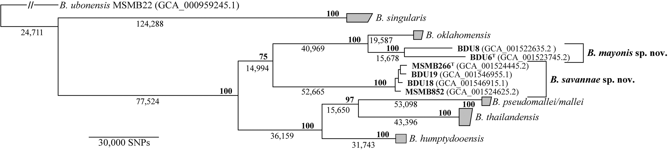
Part 4: Refine your visualisation
Use iToL to make your tree more informative
Compare your gene tree with a more comprehensive species tree
Read through the material and answer the MyPlace formative quiz
Hall et al. (2022) https://doi.org/10.1128/AEM.01583-21
Notes:
You refine the visualization of your tree to make it more informative, and compare your _gene tree_ (based only on a single gene) to a much more comprehensive _species tree_ (based on many genes) to see how they might differ, and what that might mean.

Slide 23
Let’s go
Workshop materials on BM211 MyPlace page
https://classes.myplace.strath.ac.uk/course/view.php?id=21574
https://classes.myplace.strath.ac.uk/mod/url/view.php?id=1962371
Formative quizzes
https://classes.myplace.strath.ac.uk/mod/quiz/view.php?id=1962381
https://classes.myplace.strath.ac.uk/mod/quiz/view.php?id=1962380
https://classes.myplace.strath.ac.uk/mod/quiz/view.php?id=1962375
https://classes.myplace.strath.ac.uk/mod/quiz/view.php?id=1962372
Ask me or Dr Feeney if you need assistance
Notes:
As ever, if you have any questions, please put your hand up and Dr Feeney or I will help you out.
But for now, let’s get started on the workshop.

Slide 25
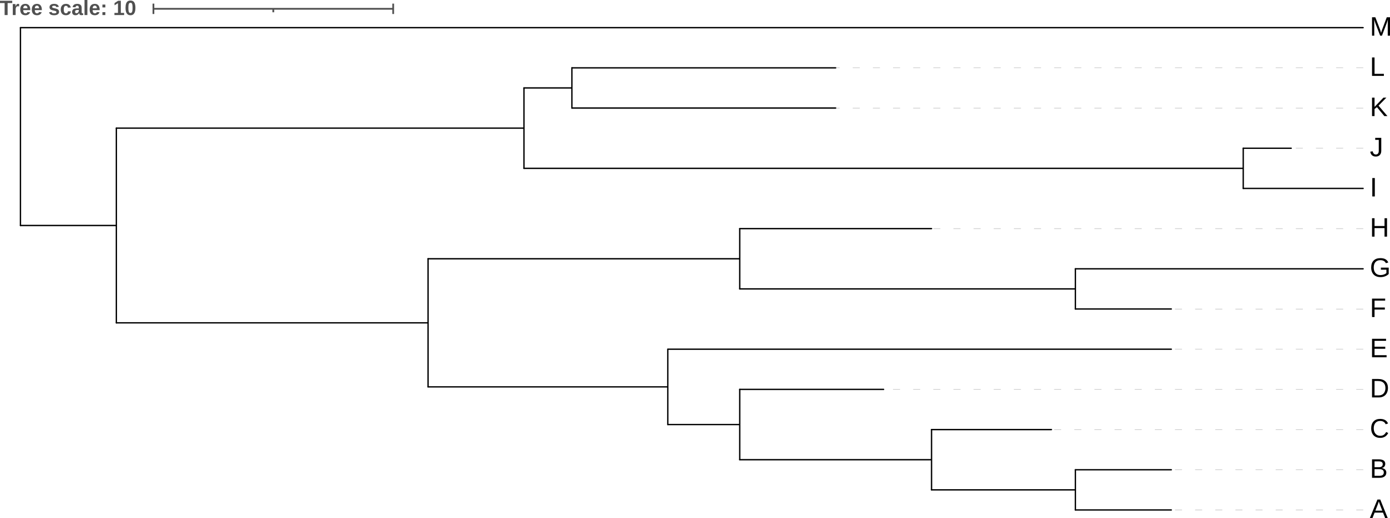
ancestors
Genetic change (≈time?)
descendants
clade1
clade2
clade3
clade4

